Slide 1

Introduction to Software Business Product management
Week 1 Day 3
Led by:
Emily Crose
Oakland University

Slide 2





Day 2 recap

Slide 3


Question or Clarifications?

Slide 4

Networking

Slide 5
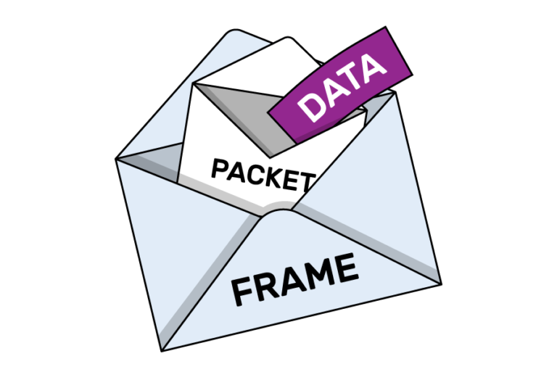
Packets

Slide 6
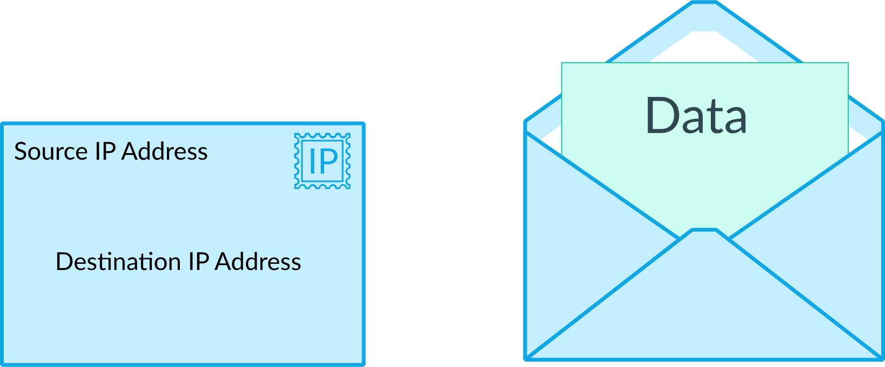

Slide 7
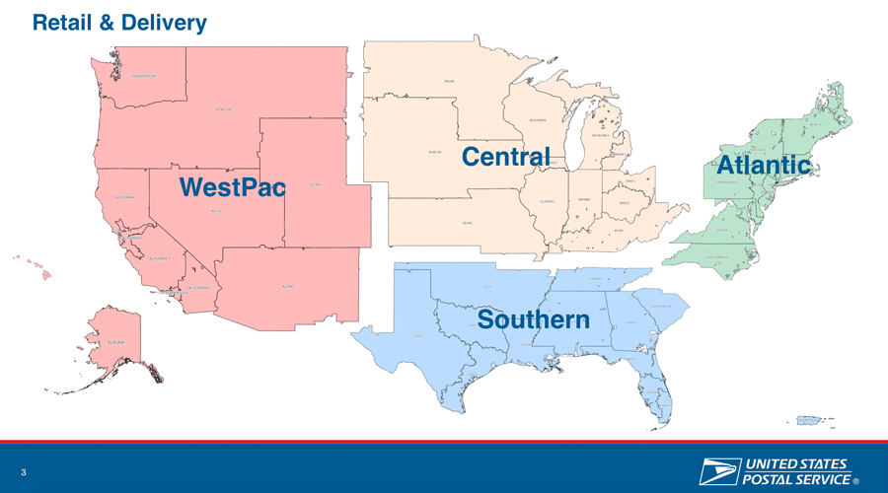

Slide 8
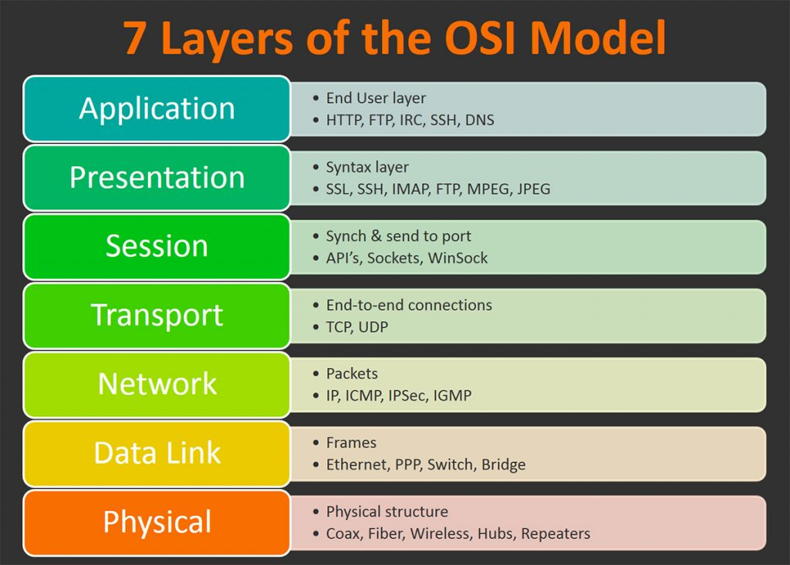

Slide 9
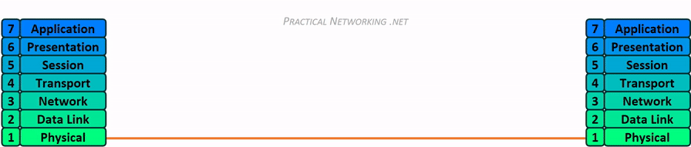
Network Transmission

Slide 10

Layer 1- Physical
Media Layer

Slide 11
Networking Hardware
Purpose
Provides a physical medium for transporting raw information
Wireless Antenna
Cat5 (Ethernet) Cables
Coaxial Cables
Fiber Optic Cables
Network Hubs
Network Repeaters

Slide 12

Layer 2 - Data Link
Media layer

Slide 13
Layer 2
Purpose
Provides error-free transfer of data frames from one node to another via the physical layer
Physical
Network Switch
Network Bridge
Logical
“Frames”

Slide 14
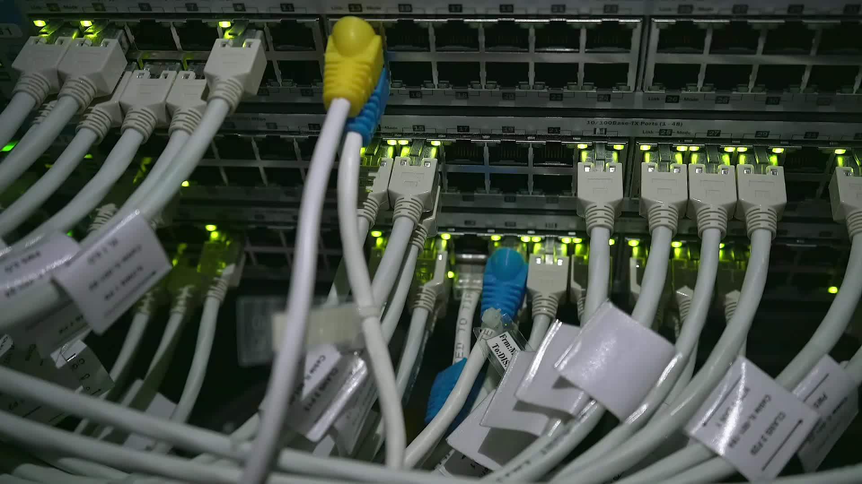
Layer 3 - Network
Media Layer

Slide 15
Layer 3
Purpose
Controls the operations of the subnet.
Decides which physical path data will take
Physical
Router
Logical (Protocols)
IP
ICMP
IPSec
IGMP

Slide 16
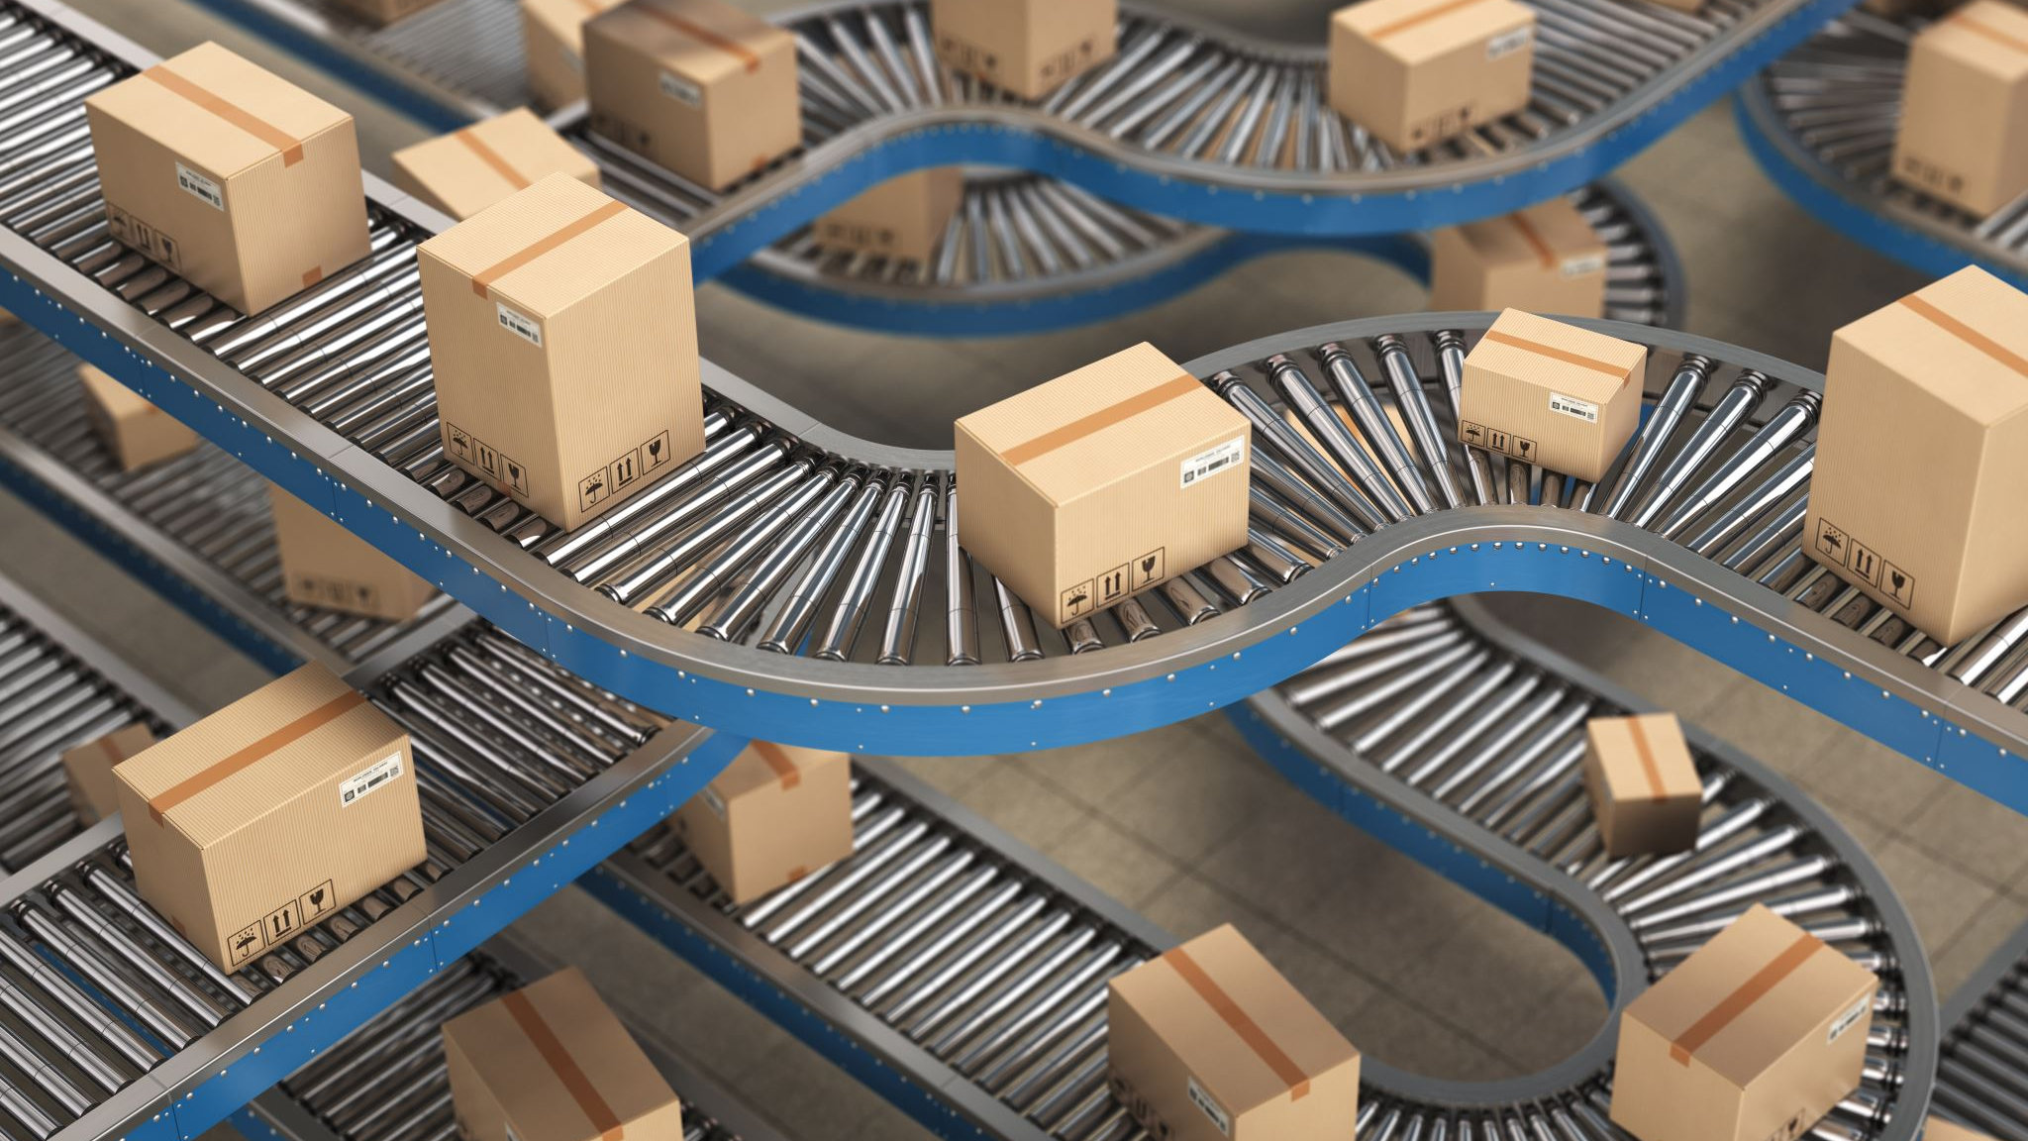
Layer 4 - Transport
Host Layer

Slide 17
Layer 4
Purpose
Ensures that messages are delivered in sequence without losses, errors or duplications
Logical
TCP
UDP

Slide 18

10 minute break

Slide 19
TCP VS. UDP

Slide 20
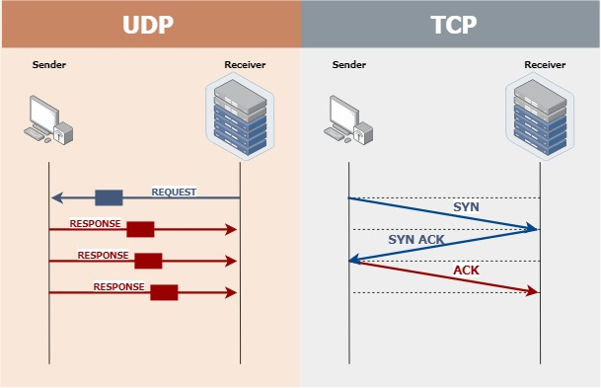

Slide 21
Layer 5 – Session
Host layer

Slide 22
Layer 5
Purpose
Allows the establishment of sessions between processes
Protocols
RPC
SQL
NFS
Netbios

Slide 23

Layer 6 – Presentatioin
Host layer

Slide 24
Layer 6
Purpose
Formats data bound for the application layer (layer 7)
Protocols
JPG
ASCII
ANSI
GIF
WEBP

Slide 25

Layer 7 – Application
Host layer

Slide 26
Layer 7
Purpose
Interface layers for users to access network resources
Protocols
SMTP
HTTP
Wiki
Microsoft Word

Slide 27

Shall We Play A Game?
https://static-labs.tryhackme.cloud/sites/osi-model-game/
Notes:
Let’s play a little network protocol game and see if we can remember the 7 layers of the OSI model!

Slide 28

Problem: How Do We Move Information?

Slide 29
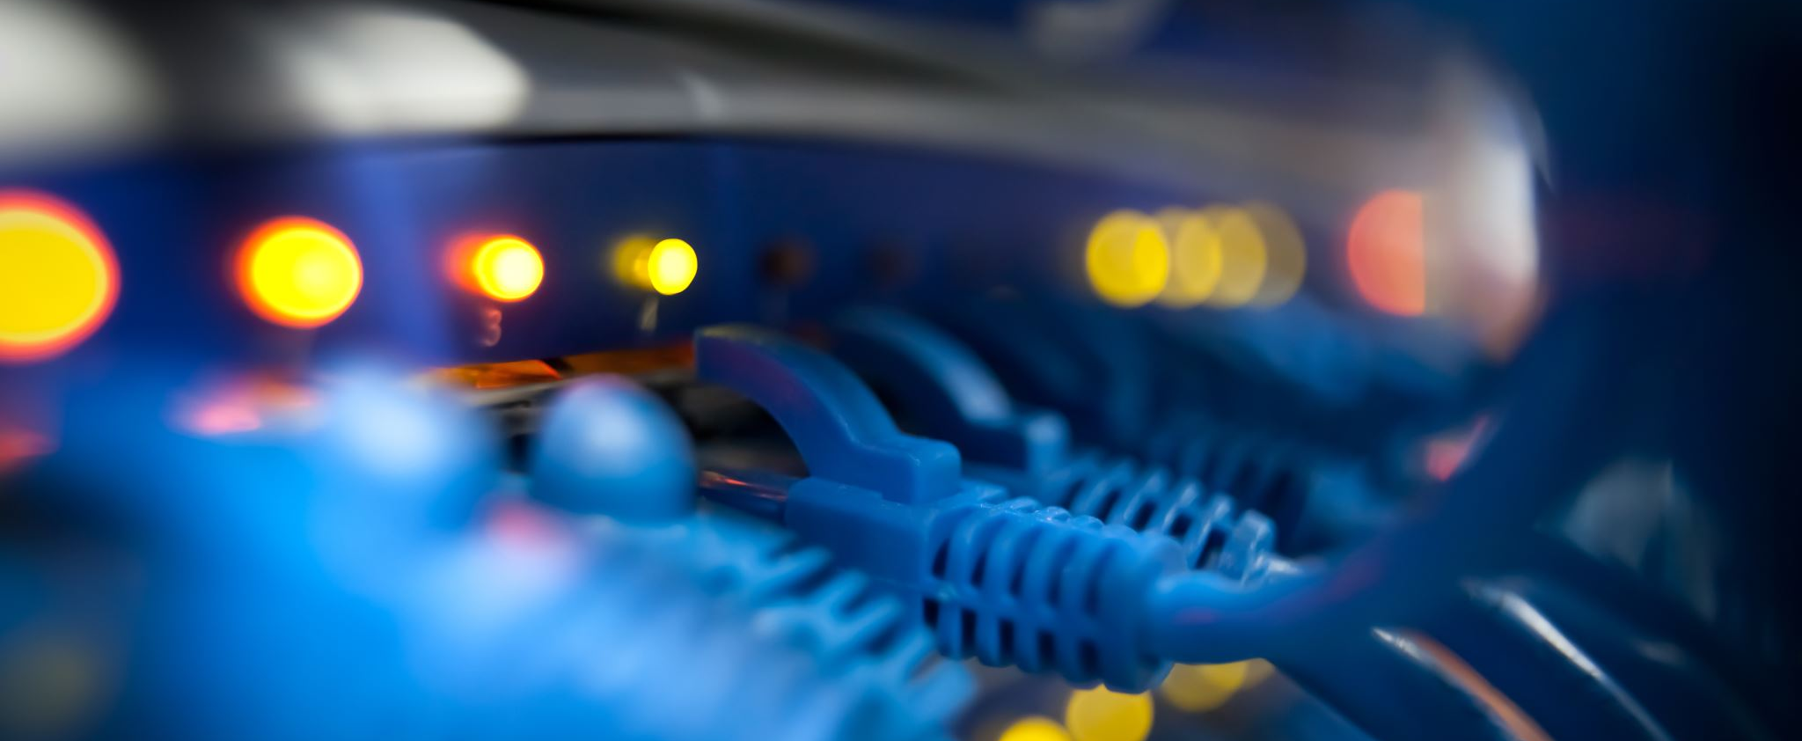
LANs and WANs

Slide 30
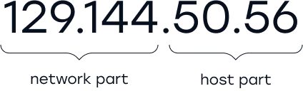
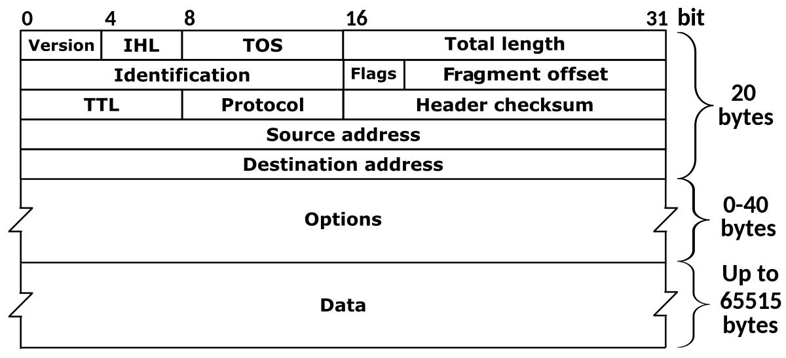
Network Operation

Slide 31
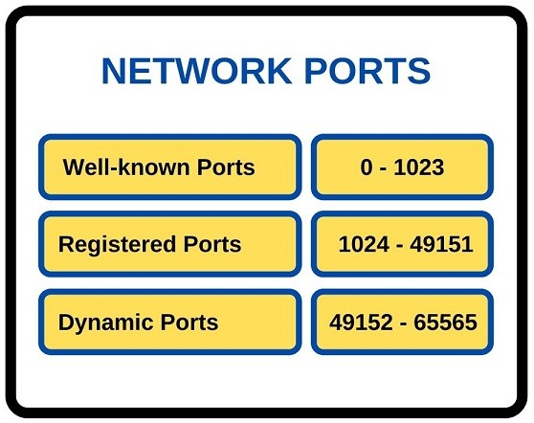
Network Ports

Slide 32
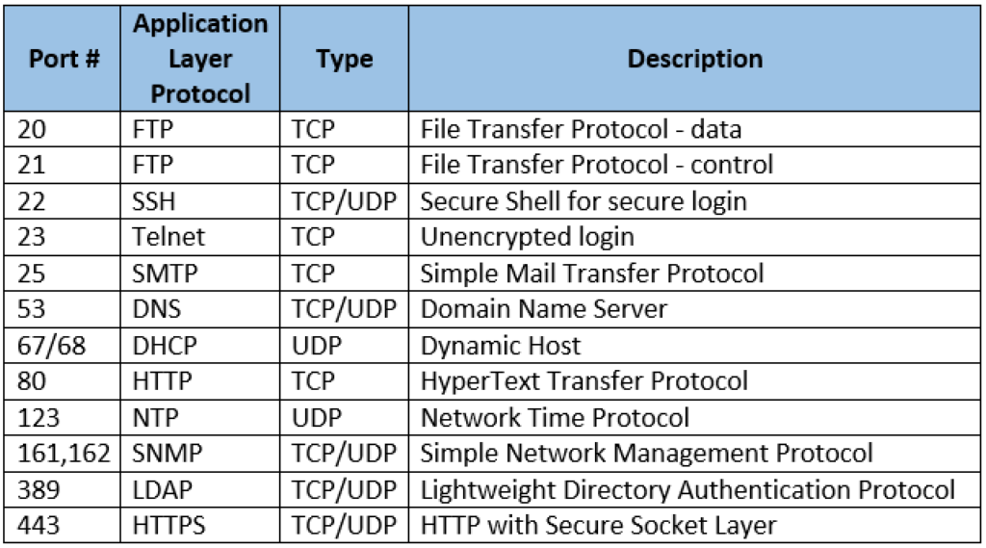
Common Network Ports

Slide 33
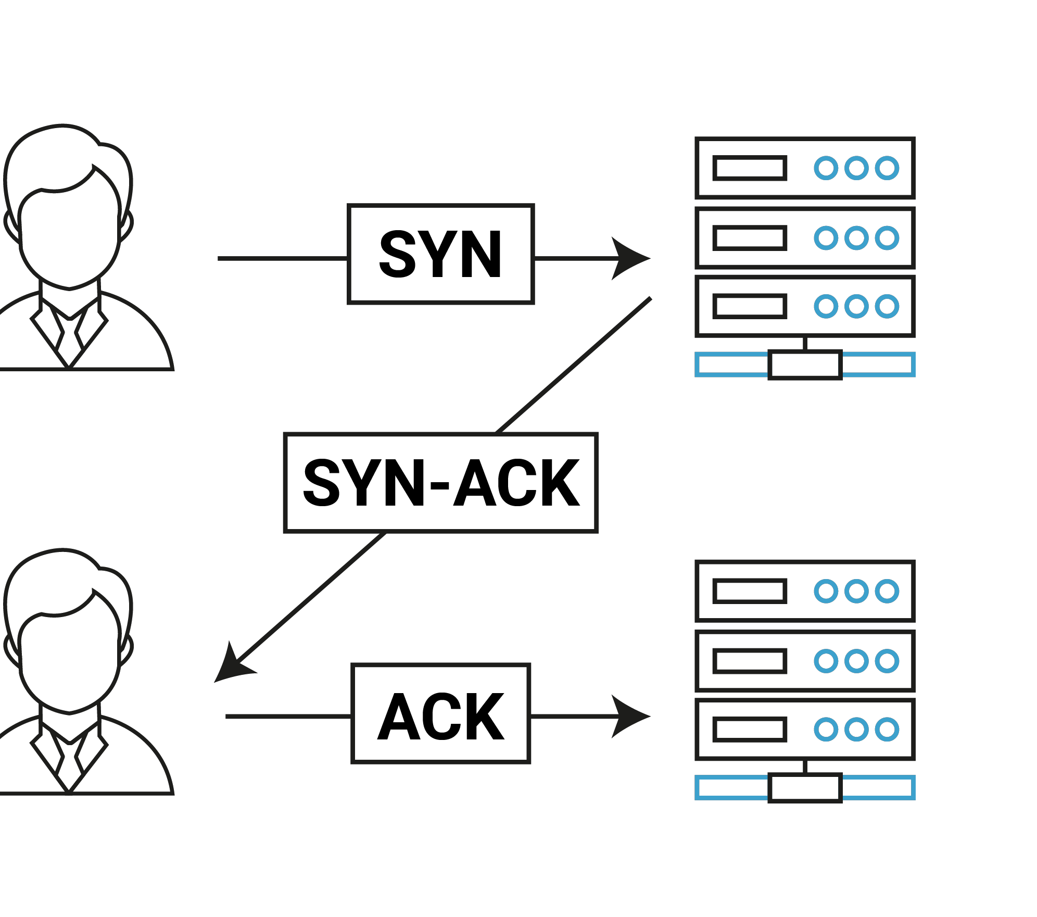
TCP 3-Way Handshake

Slide 34
Local Area Network (LAN)
Allows connection to other nearby network-connected systems
You probably use some of these devices!
Amazon firestick
Google Chromecast
AppleTV
More protective of local information?

Slide 35
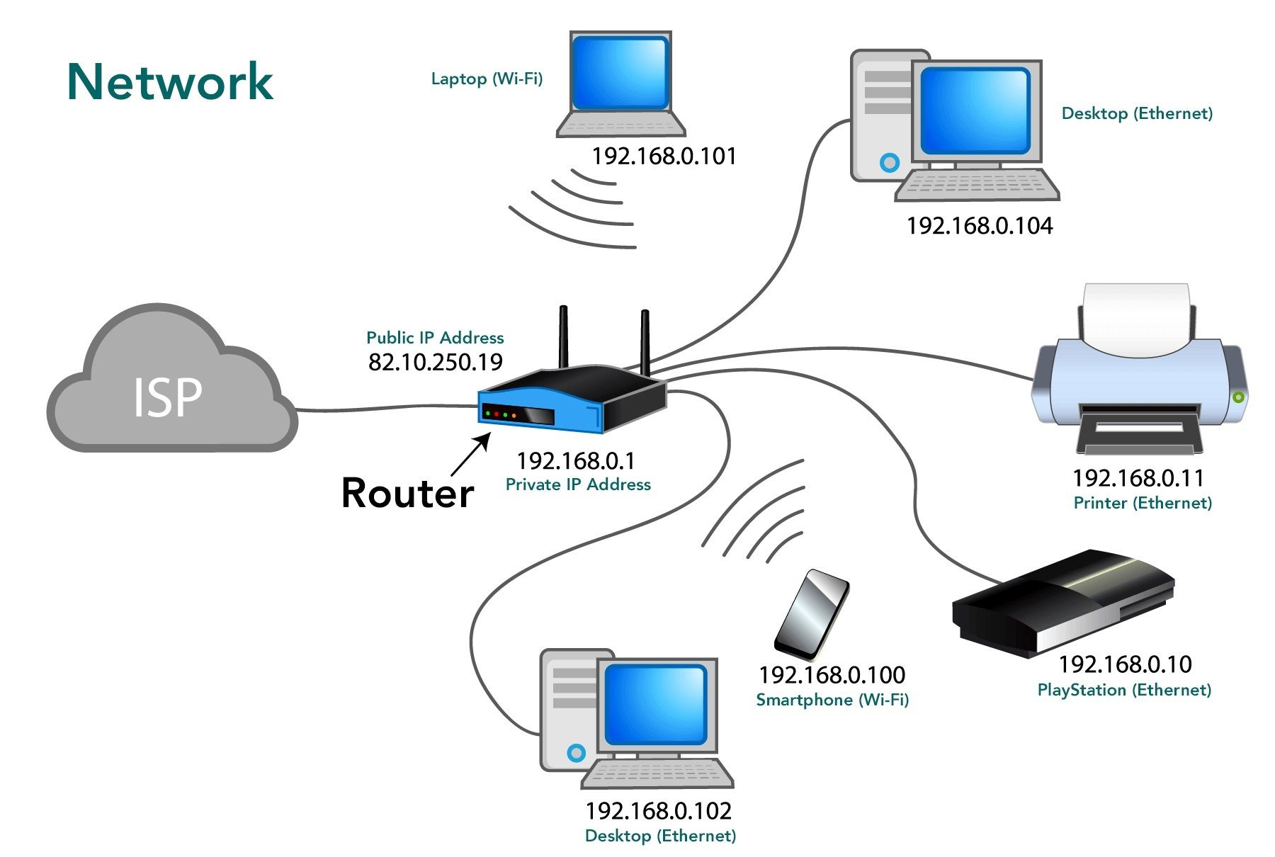
Basic Network Topology

Slide 36
Wide Area Network (WAN)
Allows connection to remote hosts
Websites
Remote backups/repositories
VPNs enable access to remote LANs

Slide 37
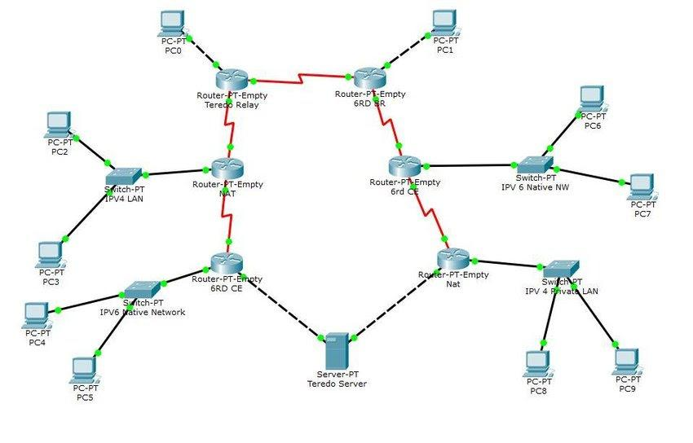
Complex Network Topology

Slide 38
10 minute break

Slide 39

How Do Apps Access Information?

Slide 40
Local & Remote Information
Local filesystem
Remote filesystem
Repositories
Databases
Local hard drive
Hard drive on another computer
Structured data
Typically holds frequently changing information
SQL, MSAccess, etc.

Slide 41
Day 3 Recap

Slide 42
Question or Clarifications?

Slide 43
Instructor Contact Info
ecrose@oakland.edu

